Slide 1
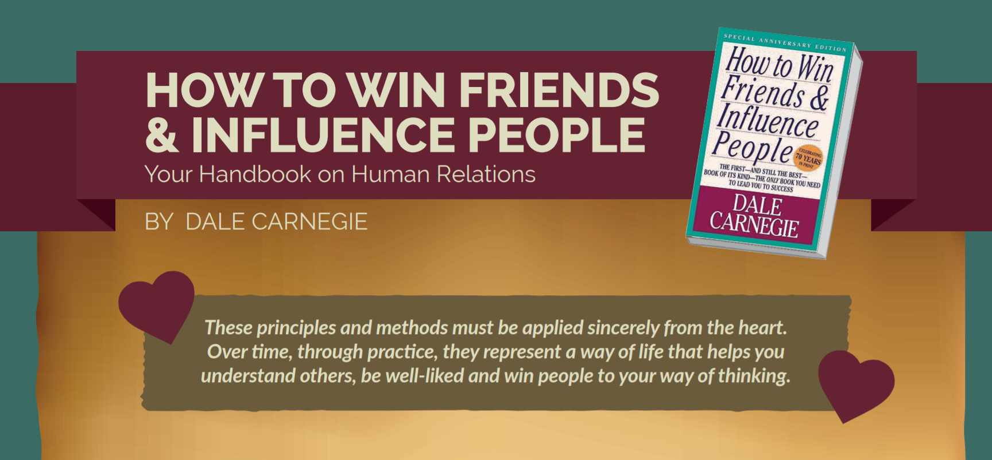

Slide 2
SUMMARY
80 years
1936
45 million copies

Slide 3
TOPICS
Part 1: Fundamental Techniques in Handling People
3 Principles covered
Part 2: Six Ways to Make People Like You
6 Principles covered
Part 3: How to Win People to your Way of Thinking
12 Principles covered
Part 4: Be a Leader: How to change People Without Giving Offence or Arousing Resentment
9 Principles covered

Slide 4



3 Fundamental Techniques In Handling People
Don’t criticize, condemn or complain
Give honest and sincere appreciation
Arouse in other person an eager want

Slide 5
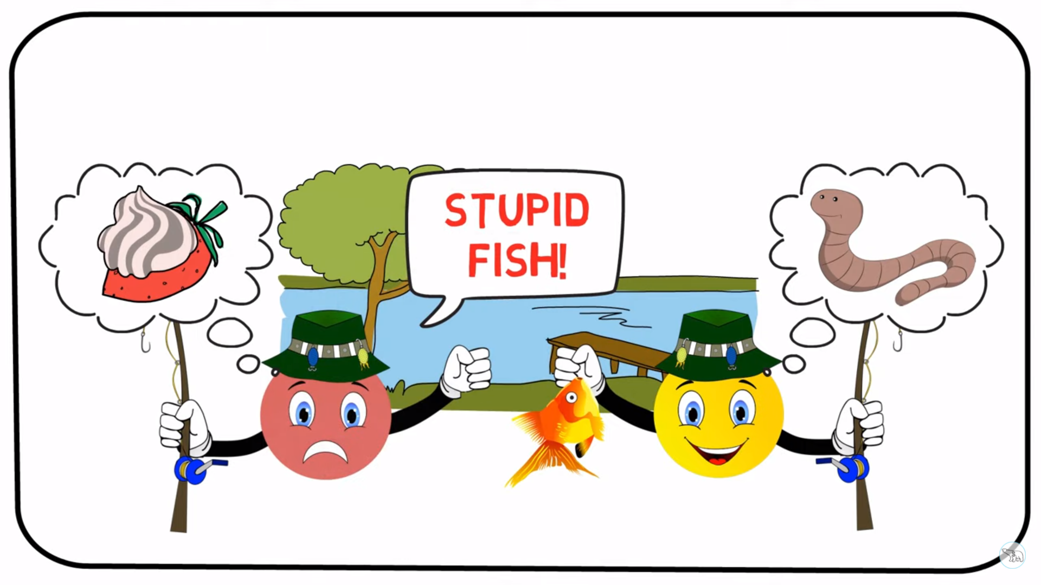

Slide 6






6 Ways To Make People Like You
Smile
Become genuinely interested in others
Remember names
Listen effectively & Encourage others
Make others feel important (do it sincerely)
Talk in terms of their interests

Slide 7




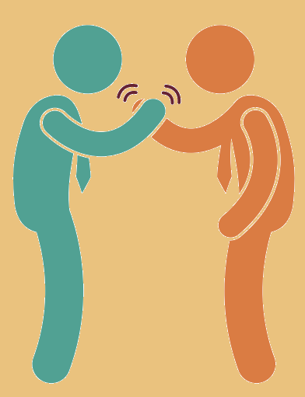

12 Ways To Win People to Your Way of Thinking
Avoid Arguments
Admit to your mistakes quickly
Get to “Yes, Yes” asap
Respect Others’ Opinions
Begin in a friendly way
Let Others talk more

Slide 8






12 Ways To Win People to Your Way of Thinking
Let others “own” the ideas
Be sympathetic
Dramatize your ideas
See from others’ point of view
Appeal to nobler motives
Throw a challenge

Slide 9









9 Ways To Win Change People Without Causing Offense Or resentment
Highlight others’ mistakes indirectly
Ask questions, don’t issue orders
Praise any improvement
Make correction seem easy
Start with praise
& appreciation
Talk about your own mistakes first
Let others save face
Act as if they were better
Help them see their benefits

Slide 10

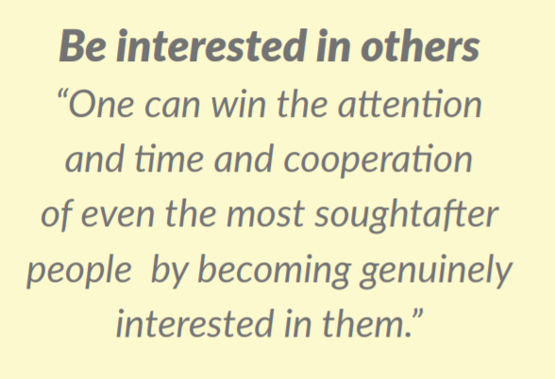
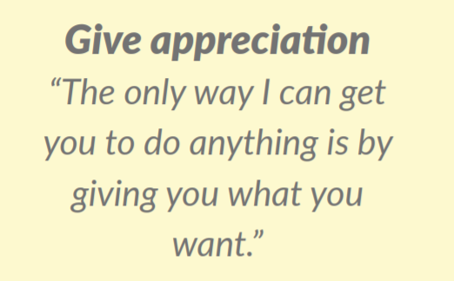
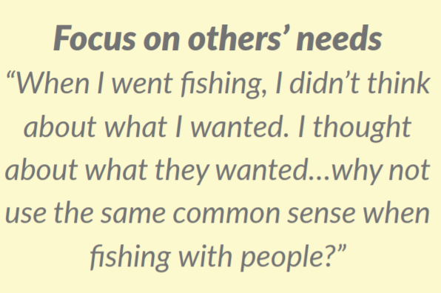

Slide 11
Thanks !

